Slide 1
Web Automation with SELENIUM
PROJECT
ANURAG VAID

Slide 2
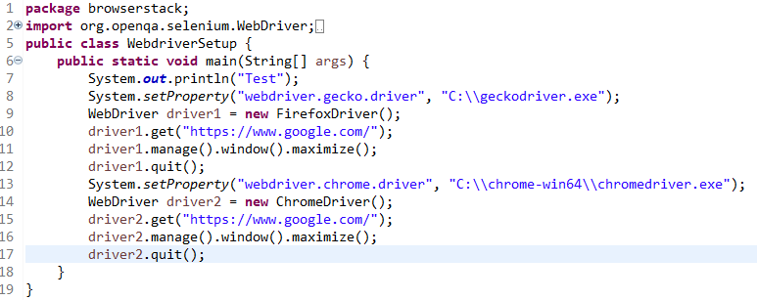

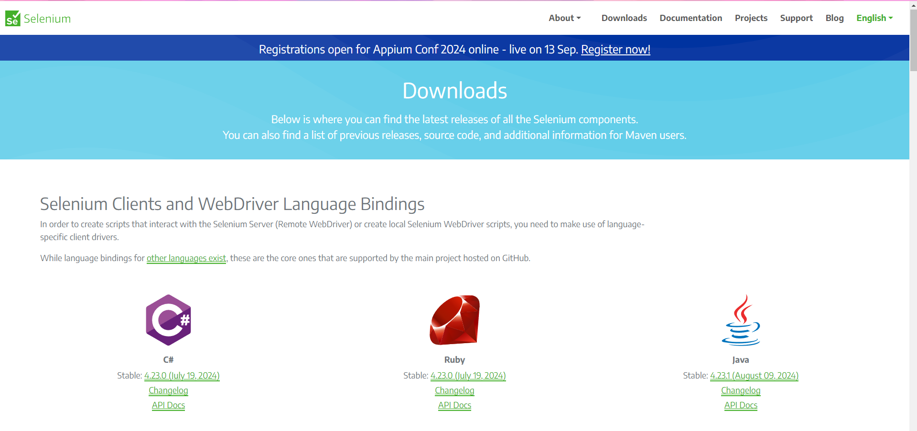
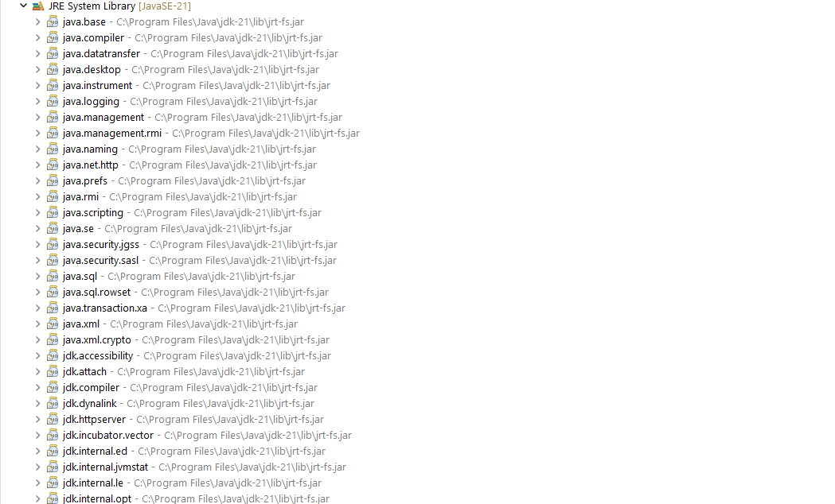
Part I (Environment Setup and Basics)

Slide 3
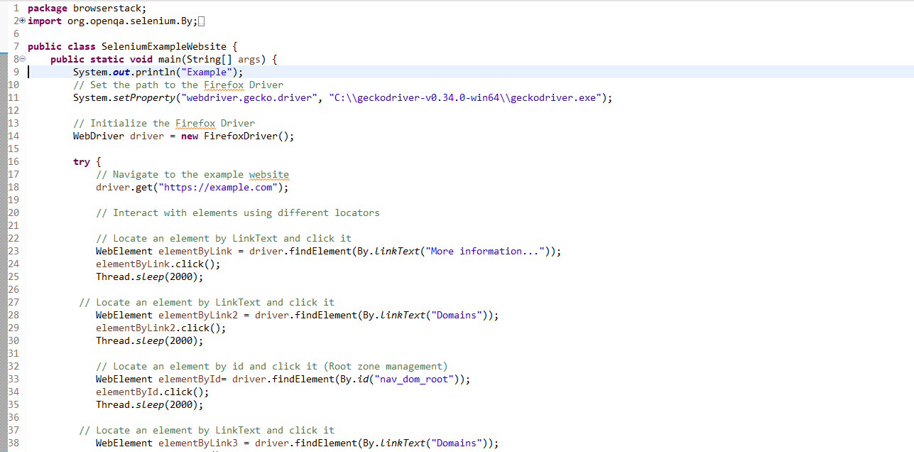
Example Website(https://example.com/)

Slide 4
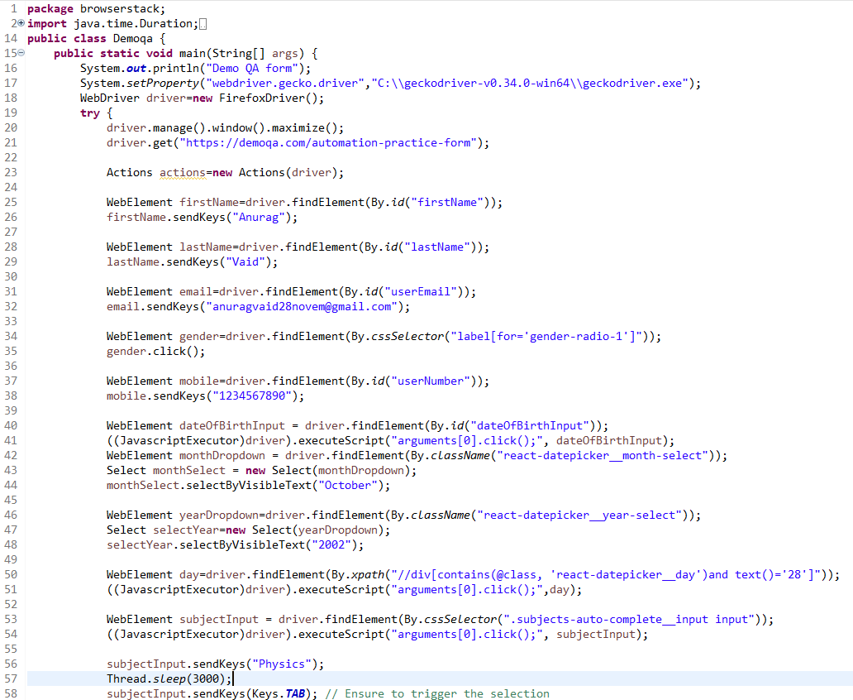
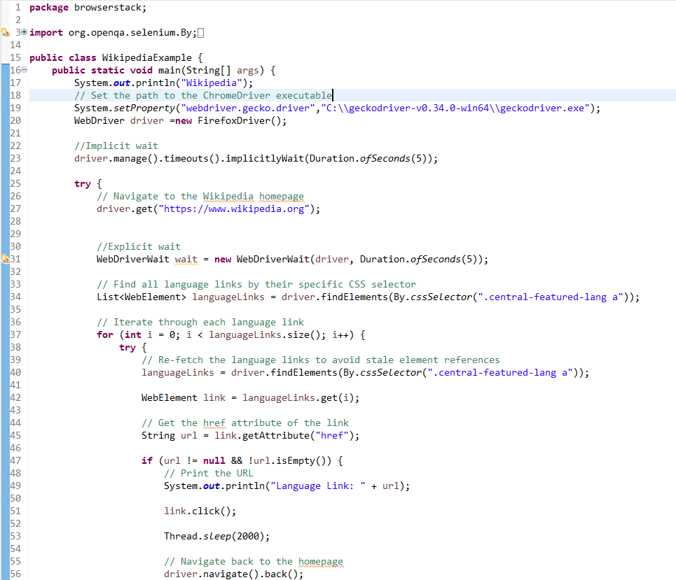
Part II (DemoQAFormsPage & Wikipedia)

Slide 5
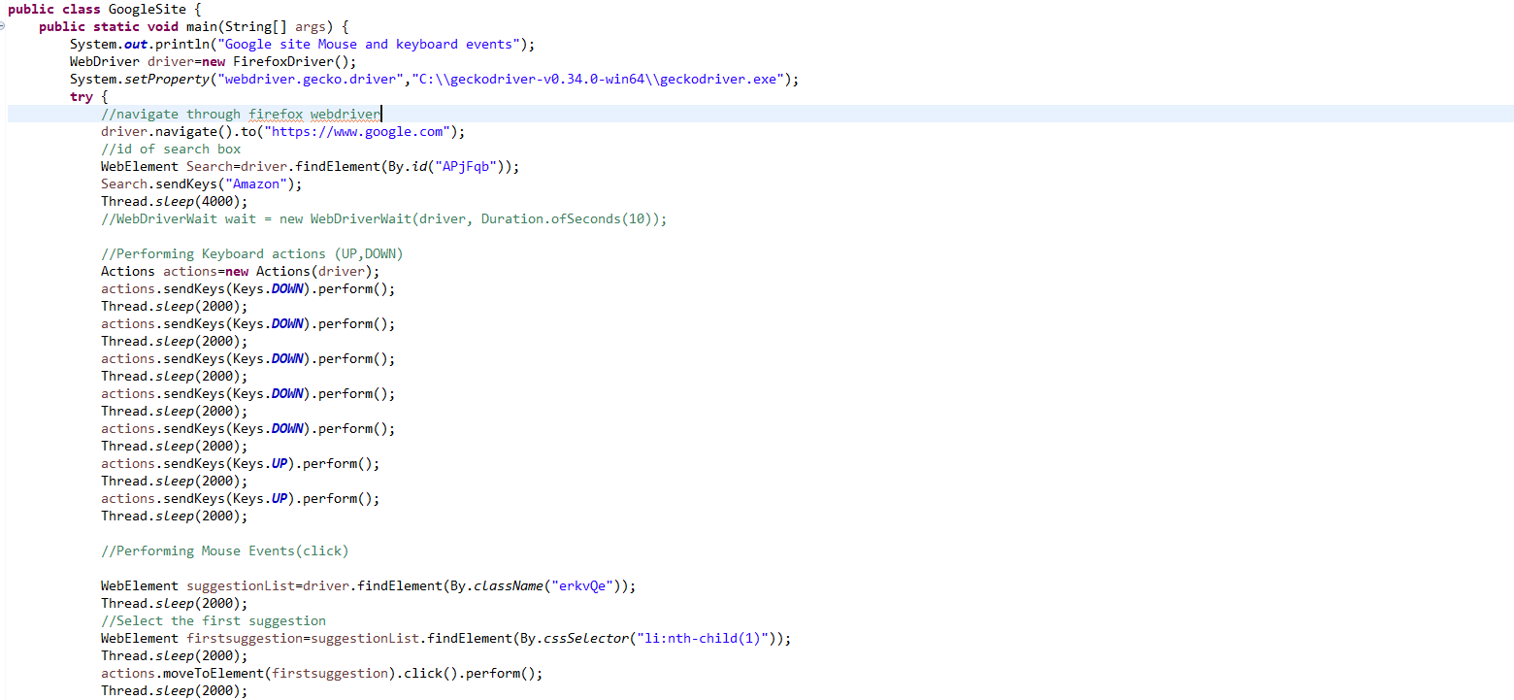
Keyboard,Mouse Events(Google.com)

Slide 6
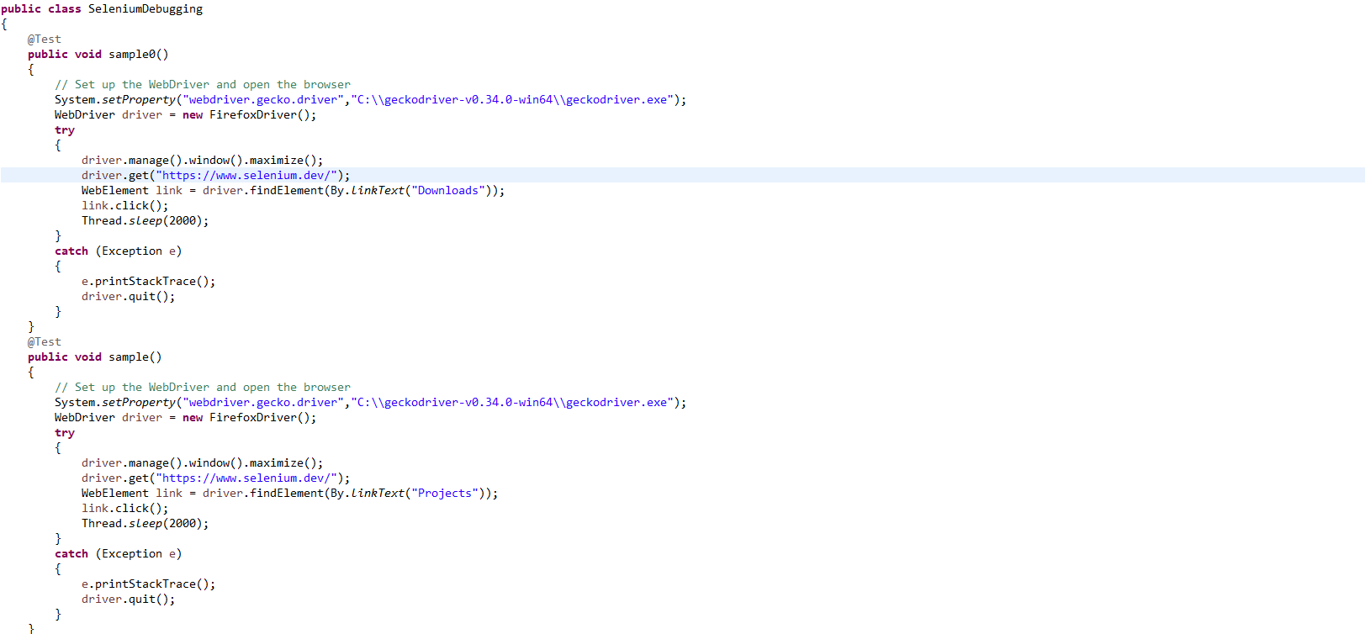
Debugging Tests(https://www.selenium.dev/)

Slide 7
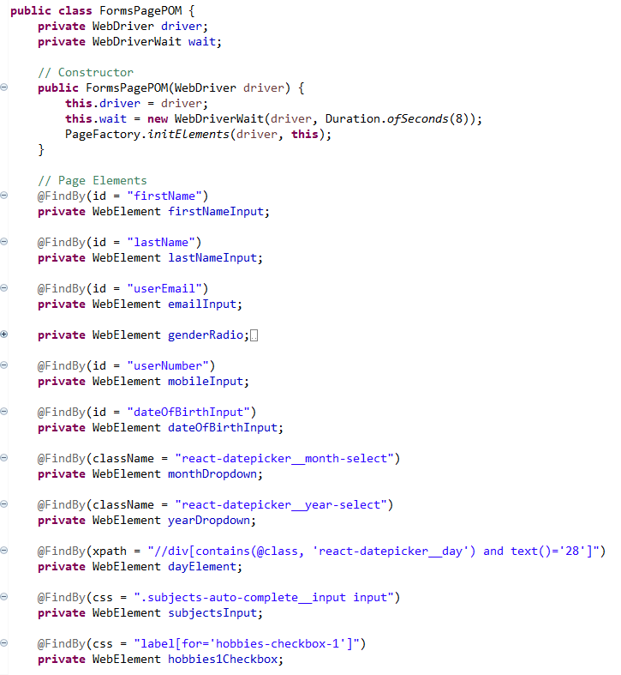
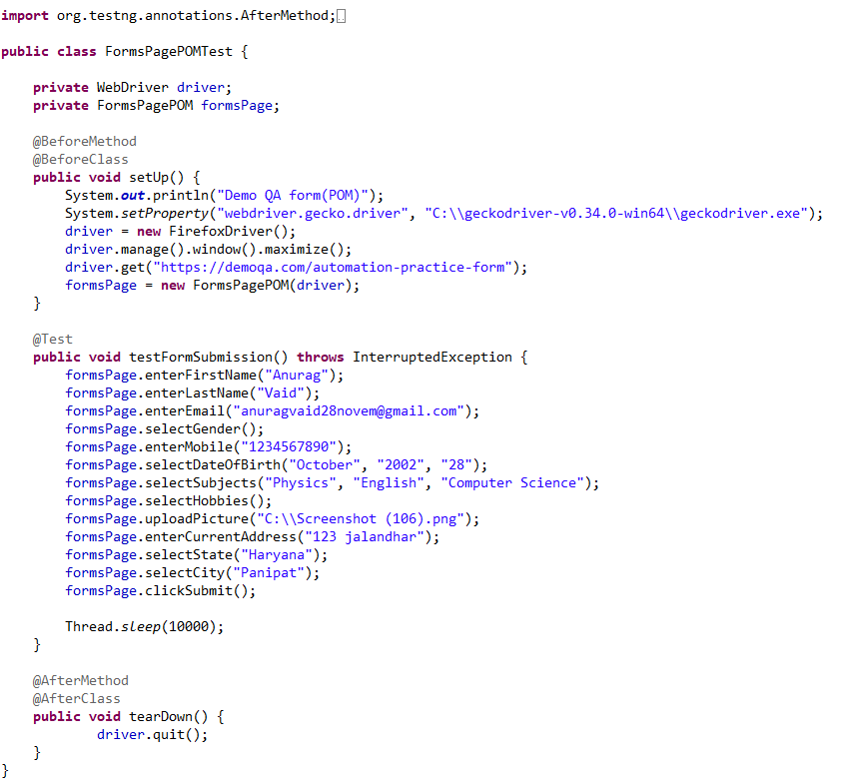
Part III (POM DemoQAFormsPage)

Slide 8
THANK YOU😊

